Slide 1












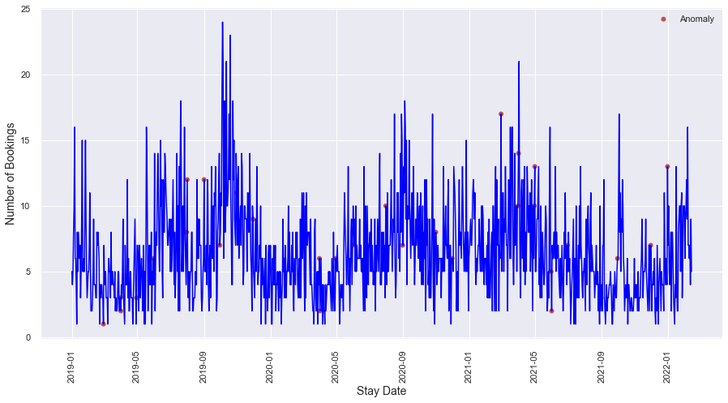
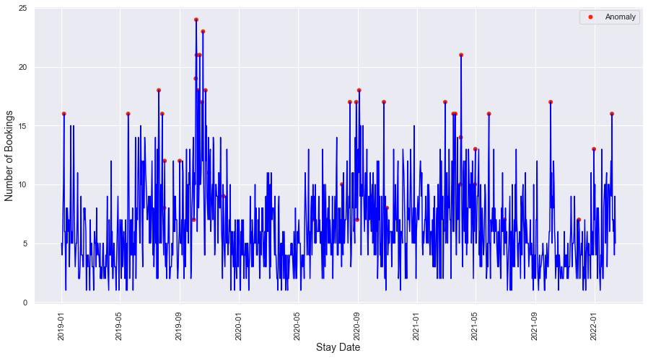



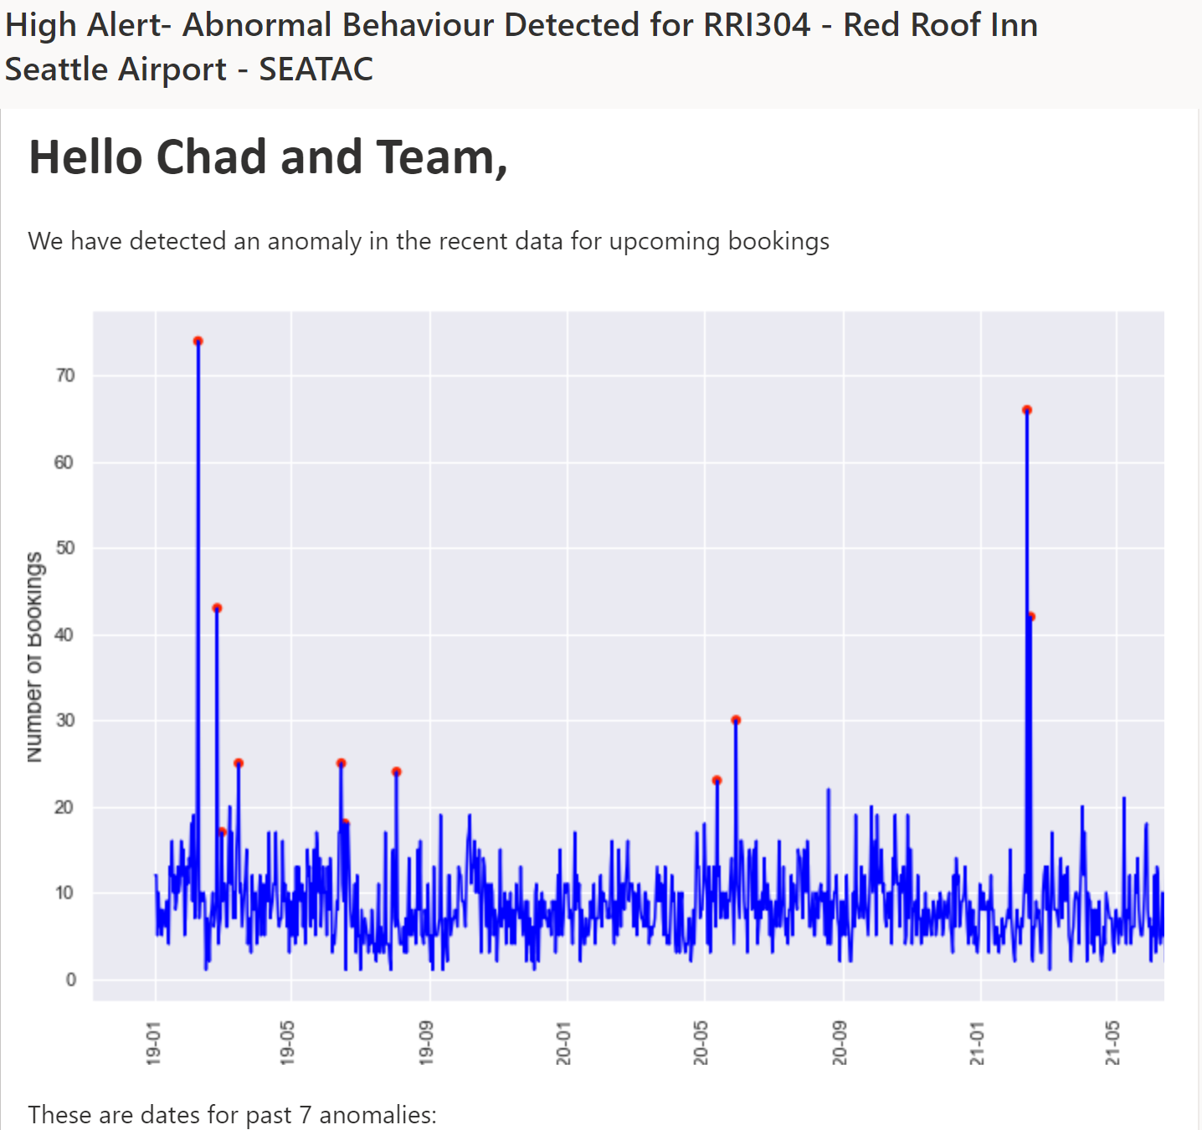
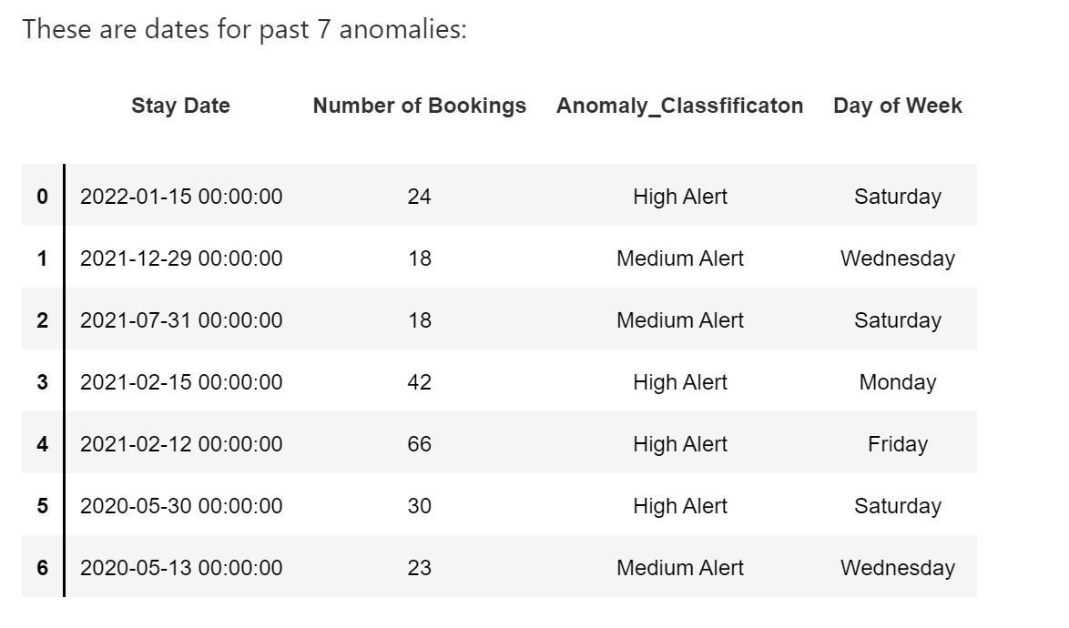

Mitigating Hotel Revenue Management System Risk Using Anomaly Detection in Short Booking Windows
Pranoy Bhattacharya, Pratyusha Gajavalli, Surya Sathiyamurthy, Rishabh Sharma, Evan Tiffany, Matthew A. Lanham
Purdue University, Krannert School of Management
bhatta56@purdue.edu; pgajaval@purdue.edu; sharm451@purdue.edu; ssathiya@purdue.edu; etiffany@purdue.edu; lanhamm@purdue.edu
METHODOLOGY
ANOMALY DETECTION & ALERT SYSTEM
EXPECTED IMPACT
Data Preprocessing
Among the many models used for anomaly detection for booking in the last 48-hour window, there were many underperforming models like isolation forest, clustering models, etc. The best performing models were PCA, Clustering-based detection, and standard deviation. From figure 3, the combined model was able to detect both low and high demand anomalies whereas PCA only (Figure 4) was able to identify only the high demand anomalies. Local anomalies were also discovered in the combined model.
From our combined model, an accuracy was determined through visual inspection with insight from personnel familiar with the data. The combined model produced a true positive rate around 83% and a false positive rate around 1%.
Assuming optimal pricing can be determined from the demand alert, different rates of revenue increases were predicted for each level of anomaly. From these predictions, we figured the average increase in revenue per year to be from 2.6% to 3.5%. Each day the alert helps aid the manager optimally price the bookings, a predicted an increase in revenue of 34% to 46%.
ABSTRACT
Data from past 3 years - 2019 to 2021
Training Data
Feature selection
Property code, stay date, nights, 24-hour lag, 48-hour lag
Investigating anomaly detection for improved pricing decisions for economy hotels within 48 hours. In order to satisfy demand at a price and achieve the greatest revenue, PCA, clustering, and rule-based models are used to detect anomalies in the 48-hour window using historical data and an alert system was built on top of it. These alerts were categorized to high, medium, or low alerts and sent to revenue managers, helping them adjust prices and resources accordingly and mitigate risk.
Data
Data cleaning
EDA
All Properties
INTRODUCTION
Test Data
Anomaly Detection
Cluster based
PCA
Std dev
Other Models
Property type 1
Property type 2
Economy hotel chains experience high demand variability within 48 hours of each booking date. These demands do not have high visibility, affect the price, and make these hotels less competitive. The addition of anomaly detection help monitor demand in real-time and optimize revenue. Finding the right model to detect the anomaly and alerting the hotel operators to optimize their prices can increase the potential for hotels to maximize their revenue.
Validation of other properties from hotel chain
Algorithm Selection:
Clustering Based Anomaly Detection
Algorithm Selection:
Combination of Clustering & PCA
~83%
~1%
Best Model
Best algorithm depends on property type
True Positive Rate =
True Positives (TP) / Actual Positives
False Positive Rate =
False Positives (FP) / Actual Negatives
Fig 5. Accuracy of predicted anomaly detection
Rule Selection:
Points >= 3 Std.dev above mean is an anomaly; Remove points < 3 Std.dev below mean
Rule Selection:
Points >= 3 Std.dev above mean is an anomaly; Remove points < 3 Std.dev below mean
> 80 K
+ 2.6 to 3.5%
Issues Today
Solution
Detection of anomaly and classification of its type
Anomaly in booking
Total Bookings from >10 K days
Low visibility in changing demand.
Monitor the demand in real-time.
Alert System
Fig 2. Model Summary for different property types
Overall increase in revenue over
total bookings
Details like anomaly date, # of bookings, anomaly type, past bookings
Report generation
Before
After
~ 6 K / 7%
+ 34% to 46%
Affects the price mark-up; reduced revenue optimization.
Build an alert mechanism in real-time anomalies in demand.
Increase in Revenue for specific days in which anomalies are detected
Alerts sent to revenue managers with their names and email ids
Alert to system
Total Bookings from ~150 days that are anomalies based on the model / algorithm
Noncompetitive pricing increases the likelihood of booking a competitor's property.
Utilization by Property managers in decisions of price for the property.
Alert System
Fig 6. Total increase in revenue ($) based on predicted anomaly detection
Fig 1. Methodology
CONCLUSIONS
Our study is divided into 4 main steps:
MODEL REVIEW
Anomaly Detection Alert Generation Alert Classification Revenue Maximization
Approaching the development of our model, a variety of algorithms was utilized to test the accuracy with the data provided, selecting the models that provided the best performance to continue. As the data was unlabeled, we focused primarily on unsupervised models. Overall, 12 models were tested on a set of three hotels. The top three model types, PCA, Clustering and Standard Deviation, were further implemented on the set of 11 hotels.
The profit gain and cost optimization benefits from the implementation of this product have been shown to be great. The implementation should be carried out within a submarket of suburban hotels, which can then be adapted to fit a company-wide use. From this company-wide adoption, future progressions and adaptions to this product could include a broader anomaly detection scope, allowing for earlier pricing alterations based on demand, and an automatic pricing suggestion to the revenue manager based on additional key variables: room type, demand, etc.
RESEARCH OBJECTIVES
Fig 3. Model Results before and after implementation of Algorithm + Rule Selection
Property information blinded
What methodology provides a robust demand forecasting model to form the best baseline?
How can we best detect demand anomalies?
What is the optimal margin to utilize in order to neither over detect nor under detect anomalies?
Model​ | Principal Component Analysis​ | Standard Deviation​ | Clustering-based​
Pros​ | Preventative measure for sporadic anomalies​ | Basic, easily interpreted model​ | Easily visualized and interpretable​
Cons​ ​ | Anomalies on the low end were easily missed​ | Skewed data causes issues with anomaly prediction, overpredicting on the heavy tail​ | Clusters may include true anomalous points​
ACKNOWLEDGEMENTS
We would like to thank Professor Matthew Lanham and our industry partner for this opportunity, their guidance, and support on this project.
Fig 4. Snapshot of Email Alert after an anomaly is detected

